Slide 1


AlumniConnect: A Web-Based Alumni Tracking and Networking System
Presented by:
T.Rupendra (192311325)
G.Mohammad shareef(192311288)
Ch.sathish(192311032)
K Manjunadha Reddy(192372081)
Under the Supervision of:
Dr.Sudhagar D
Internet Programming - CSA4305

Slide 2
Abstract
Alumni Connect is a web-based alumni tracking and networking system.
It provides a centralized platform to connect colleges with their alumni.
The system stores and manages alumni information in a secure database.
Alumni can register, log in, and update their personal and professional profiles.
Alumni can search for and connect with fellow graduates.
The platform allows sharing of achievements, job opportunities, and career updates.
Students can interact with alumni for mentorship and career guidance.
Administrators can manage alumni records, approve registrations, and post announcements.
The system supports event management for alumni meets and college activities.
It generates reports to help the institution maintain accurate alumni records.
The platform enhances communication and collaboration between alumni, students, and the institution.

Slide 3
Introduction
The Alumni Tracking & Networking Portal is a web-based application designed to connect alumni, students, and the institution on a single platform.
It helps educational institutions maintain a centralized database of alumni information.
Alumni can register, update their profiles, and share their professional achievements.
Students can interact with alumni for mentorship, career guidance, internships, and job opportunities.
The portal provides features such as networking, messaging, event notifications, and job postings.
Administrators can efficiently manage user accounts, announcements, and alumni records.
.

Slide 4
Objectives
Objectives
Centralize alumni information.
Enable communication and networking.
Share jobs and event updates.
Strengthen institutional relationships.
Scope
Registration and profile management.
Messaging and networking.
Event and job management.
Administrative control.

Slide 5
Problem Statement & Motivation
Problem Statement
Manual alumni record management.
Lack of communication between alumni and students.
Difficult to track alumni achievements.
Motivation
Improve alumni engagement.
Provide mentorship and career guidance.
Build a strong alumni community.

Slide 6
Literature Review
S. No. | Year | Author(s) | Title of the Paper | Key Findings
1 | 2023 | Raphael Enihe & Victor Omopariola | Alumni Portal System for Nigerian Universities: A Case Study | Developed a web-based alumni portal that improves alumni registration, profile management, communication, and event participation.
2 | 2024 | Sarah Mae Rubejes-Silva | Bridging the Gap Between Universities and Alumni: A User-Centered Evaluation of a Digital Alumni Engagement Platform | Evaluated a digital alumni platform and found improved user satisfaction, better communication, and stronger alumni engagement.
3 | 2024 | Diamanto Politis et al. | Re-viewing Entrepreneurial Universities through Alumni Engagement | Highlighted the importance of alumni engagement in supporting university growth, innovation, networking, and long-term institutional development.
4 | 2025 | Gonzalo Valentín Alfaro Rojas & Juan Pedro Soplapuco-Montalvo | Trends in Alumni Networks: A Systematic Review | Reviewed recent alumni network systems and concluded that digital platforms improve networking, employability, mentorship, and alumni-institution relationships.

Slide 7
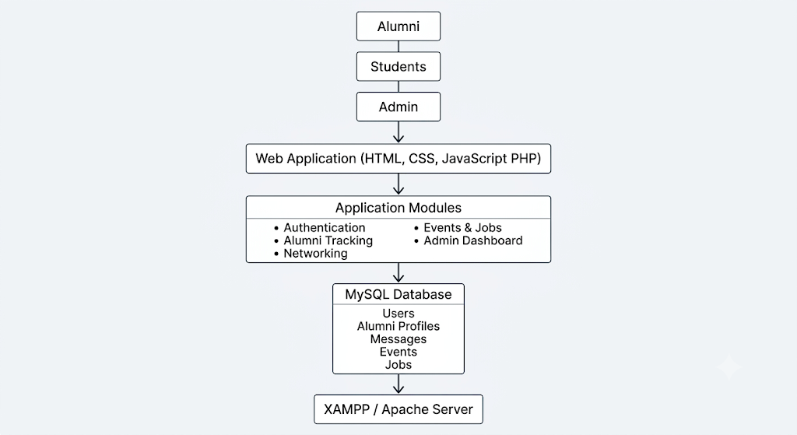
Technology Stack & System Architecture
System Architecture
Users → Web Application → Database
Technology Stack
HTML
CSS
JavaScript
PHP
MySQL
XAMPP

Slide 8
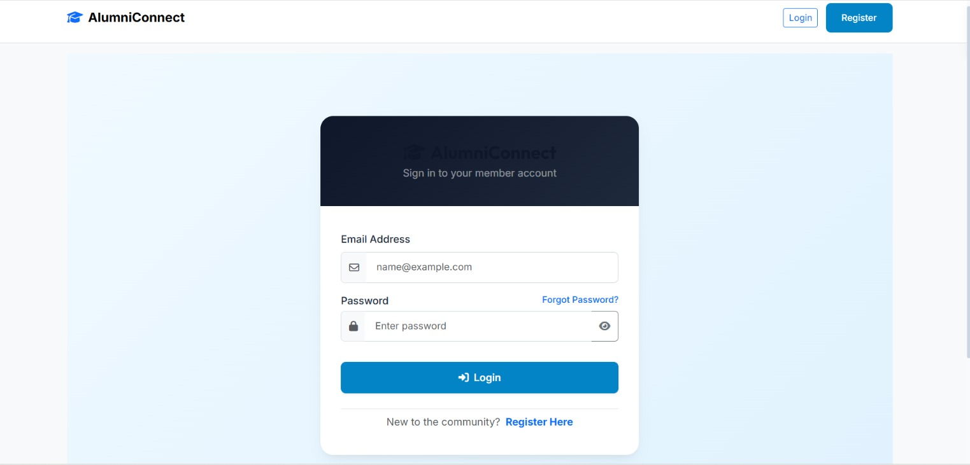
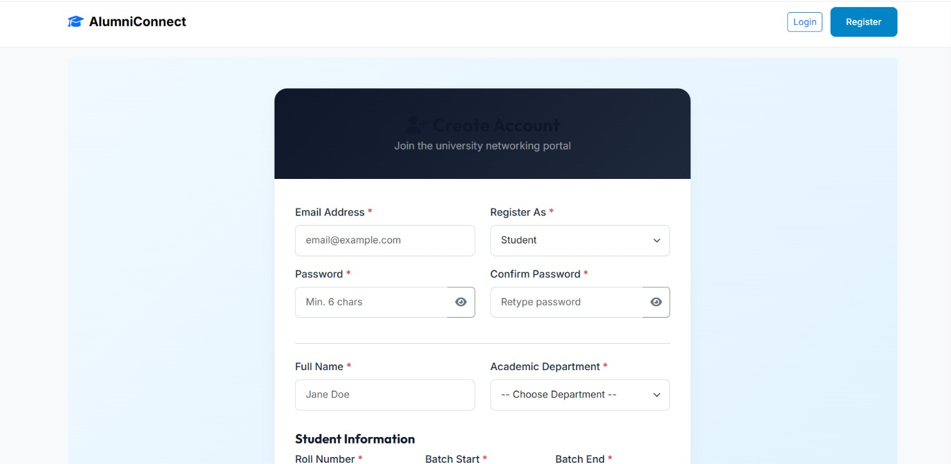
Module 1: User Authentication & Profile Management Module
Alumni, students, and administrators can register and securely log in to the system.
Secure authentication with encrypted passwords, password reset, and session management.
Create, view, and update personal profile information.
Add and update educational qualifications, graduation year, and professional details.
Upload profile photos and resumes/CVs for complete profile management.
Role-based access control to provide different permissions for Admin, Alumni, and Student users.

Slide 9
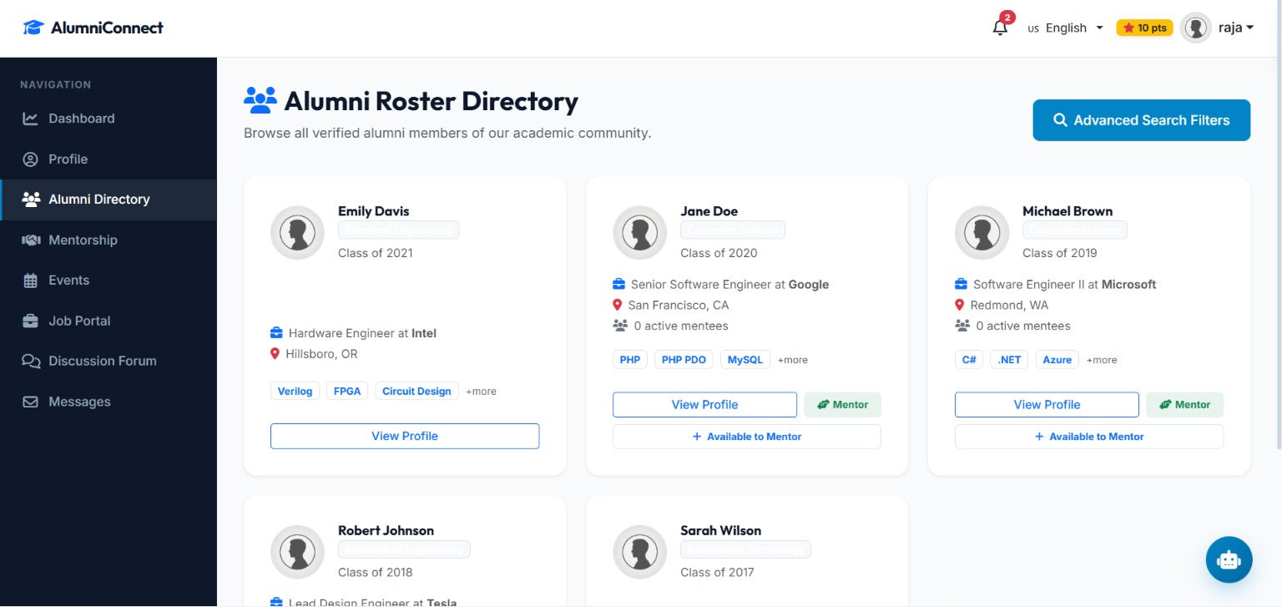
Module 2: Alumni Directory & Tracking Module
Maintain a centralized and up-to-date alumni database.
Search alumni by batch, department, graduation year, company, or location.
Track alumni career progress, achievements, and professional growth.
View alumni profiles, educational details, and contact information.
Filter and sort alumni records for quick and easy access.
Generate alumni tracking reports for institutional analysis and record management.

Slide 10
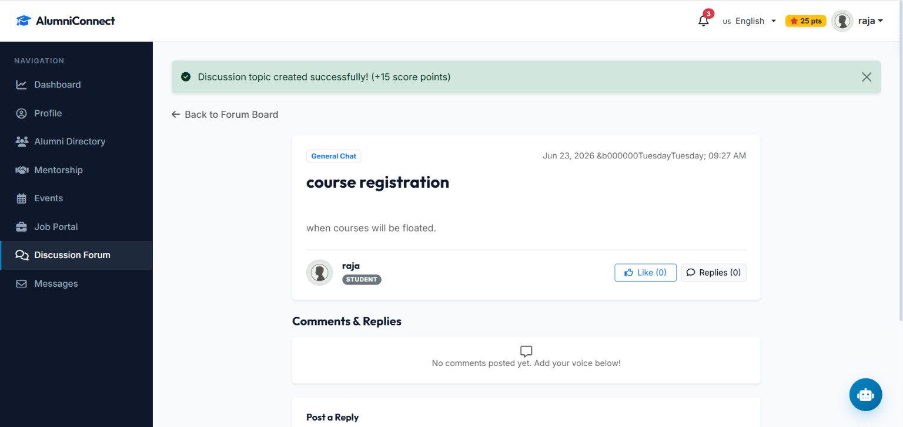
Module 3: Networking & Communication Module
Send and receive messages between alumni, students, and administrators.
Participate in discussion forums and community groups for knowledge sharing.
Connect with alumni for mentorship, career guidance, and professional networking.
Receive notifications for events, announcements, and important updates.
Share achievements, experiences, and success stories with the alumni community.
Build and maintain professional connections through the networking platform.

Slide 11
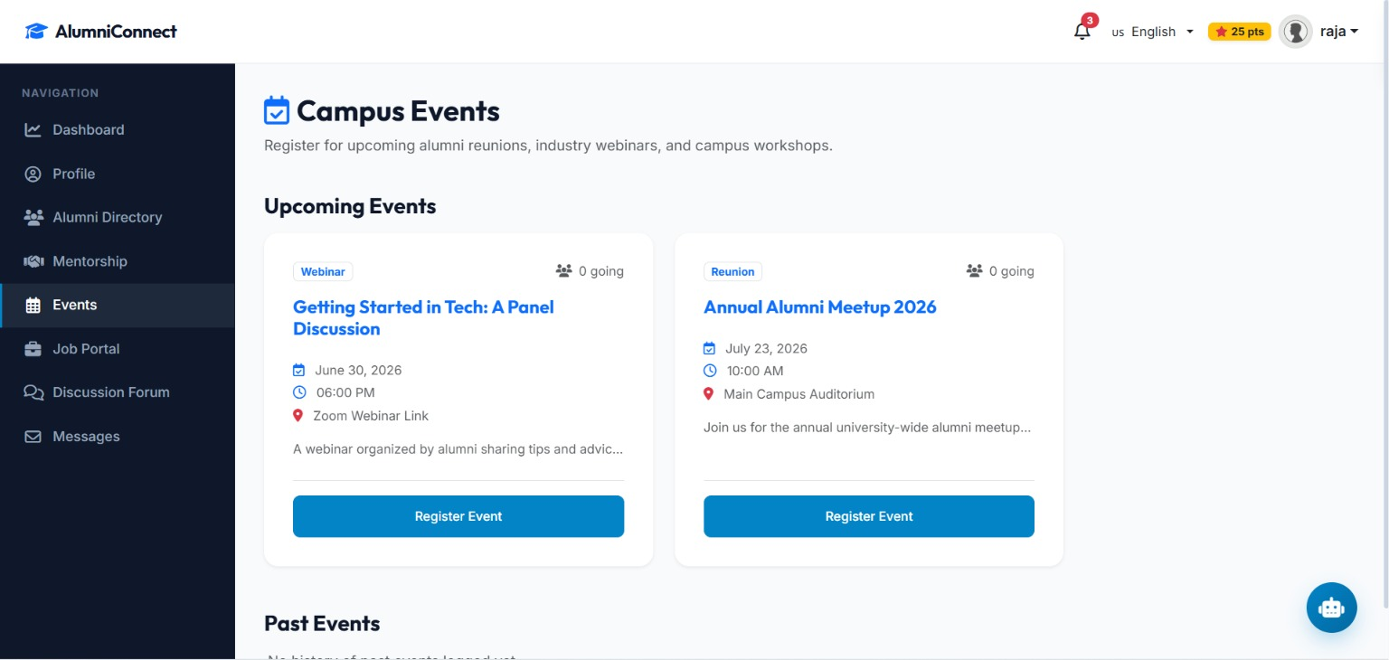
Module 4: Events & Job Opportunities Module
Post and manage alumni events, reunions, workshops, and webinars.
Share internship, job, and career opportunities for alumni and students.
Allow students and alumni to apply for available job and internship openings.
Enable online event registration and participation tracking.
Display upcoming events with schedules, venue details, and announcements.
Maintain records of event participants and job applications for future reference.

Slide 12
Conclusion
Provides a centralized platform for managing alumni information efficiently.
Strengthens communication and networking between alumni, students, and the institution.
Simplifies alumni tracking, profile management, and career updates.
Supports event management, job opportunities, and mentorship programs.
Reduces manual paperwork and improves the accuracy and security of alumni records.
Enhances long-term alumni engagement and contributes to the overall growth and reputation of the institution.

Slide 13
Future Enhancements
Develop a mobile application for Android and iOS platforms.
Integrate email and SMS notifications for events, jobs, and announcements.
Implement AI-based alumni recommendations for networking and mentorship.
Add real-time chat and video meeting features for better communication.
Introduce online donation and fundraising modules for alumni contributions.
Integrate with social media platforms such as LinkedIn for automatic profile updates.

Slide 14
References
Enihe, R., & Omopariola, V. (2023). Alumni Portal System for Nigerian Universities: A Case Study. International Journal of Scientific Research.
Sanusi, D. M., et al. (2023). An Interactive Alumni Tracking Dashboard. IEEE International Conference on Artificial Intelligence, Computing and Information Systems.
Design and Implementation of an Alumni Management System. (2023). IEEE Conference Proceedings.
Rubejes-Silva, S. M. (2024). Bridging the Gap Between Universities and Alumni: A User-Centered Evaluation of a Digital Alumni Engagement Platform. ResearchGate Publication.
Politis, D., et al. (2024). Re-viewing Entrepreneurial Universities through Alumni Engagement. Small Business Economics, Springer.

Slide 15
Thank You!

